Slide 1


International University
MICRO-PROCESSING SYSTEM
Lecture 11:
AVR I2C INTERFACE
Vo Minh Thanh, M.Eng
School Of Electrical Engineering

Slide 2
I2C BUS Protocol
The IIC (Inter-Integrated Circuit) is a bus interface connection incorporated into many devices such as Sensors, RTC, and EEPROM.
The IIC is also referred to as I2C (I²C) or I square C in many technical literatures.
The I2C bus was originally started by Philips, Now It is a widely used standard adapted by many chip making companies.
I2C is ideal for communication between low-speed devices for a reliable communication over a short distance.
I2C provides a connection oriented communi-cation with acknowledge. It uses only 2 pins for data transfer. SCL (Serial Clock), which synchronize the data transfer between two chips, and SDA (Serial Data).

Slide 3
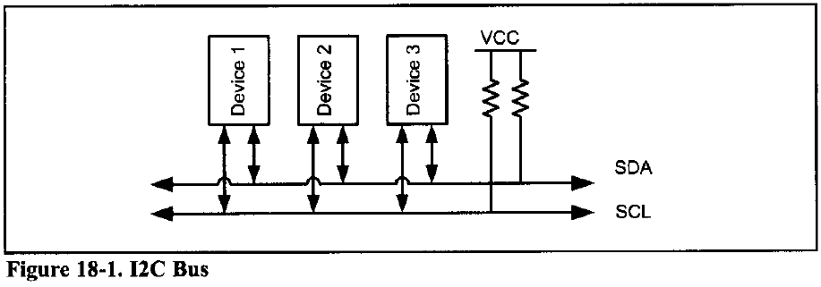
I2C BUS Protocol
This reduction of communication pins reduces the package size and power consumption making them ideal for many applications in which space is a major concern.
These two pins, SDA and SCK, make the I2C a 2-wire interface. In many application notes, including AVR datasheets, I2C is referred to as Two-Wire Serial Interface (TWI).

Slide 4
I2C Line Electrical Characteristics
I2C devices use only 2 bidirectional open-drain pins for data communication. To imple-ment I2C, only a 4.7 kilohm pull-up resistor for each of bus lines is needed (see Figure)
This implements a wired-AND, which is needed to implement I2C protocols.
This means that if one or more devices pull the line to low (zero) level, the line state is zero and the level of line will be 1 only if none of devices pull the line to low level.
I2C Nodes
In the AVR up to 120 different devices can share an I2C bus. Each of these devices is called a node. In I2C terminology, each node can operate as either master or slave.
Notes:
An open-drain or open-collector pin has output drivers that can only pull the signal line to ground. They cannot drive it high. This has the advantage that more than one device connected to a signal line may pull it low. If this were not the case, one device attempting to pull the line low while another tried to pull it high would result in a short circuit, with disastrous results. Interrupt lines are typically open-collector. All open-collector signals need a pull-up resistor and are active low. The idle state (when no device is asserting) is to be pulled high by the resistor.

Slide 5
I2C Nodes
Master is a device that generates the clock for the system; it also initiates and terminates a transmission.
Slave is the node that receives the clock and is addressed by the master. In I2C, both master and slave can receive or transmit data, so there are four modes of operation. They are:
Master Transmitter
Master Receiver
Slave Transmitter
Slave Receiver.
Notice that each node can have more than one mode of operation at different times, but it has only one mode of operation at a given time.

Slide 6
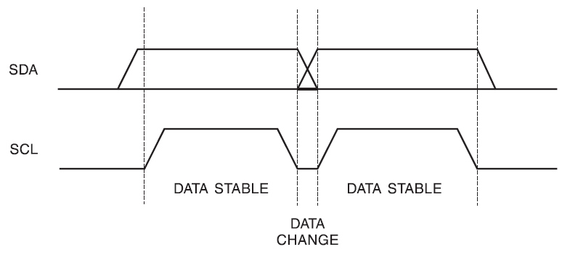
Bit Format
I2C is a synchronous serial protocol; each data bit transferred on the SDA line is synchronized by a high-to-low pulse of clock on the SCL line.
According to I2C protocols the data line cannot change when the clock line is high; it can change only when the clock line is low. See Figure 18-2. The STOP and START conditions are the only exceptions to this rule.

Slide 7
START and STOP conditions
I2C is a connection-oriented communication protocol. This means that each transmission is initiated by a START condition and is terminated by a STOP condition.
Remember that the START and STOP conditions are generated by the master.
STOP and START conditions must be distinguished from bits of address or data. That is why they do not obey the bit format rule that we mentioned before.
START and STOP conditions are generated by keeping the level of the SCL line high and then changing the level of the SDA line.
The START condition is generated by a high-to-low change in the SDA line when SCL is high.
The STOP condition is generated by a low-to-high change in the SDA line when SCL is high.

Slide 8
START and STOP conditions
The bus is considered busy between each pair of START and STOP conditions, and no other master tries to take control of the bus when it is busy.
If a master, which has the control of the bus, wishes to initiate a new transfer and does not want to release the bus before starting the new transfer, it issues a new START condition between a pair of START and STOP conditions. It is called the REPEATED START condition. See Figure 18-4.

Slide 9
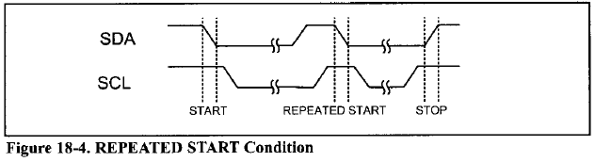
START and STOP conditions

Slide 10
START and STOP conditions
Example 18-2: Give an example to show when a master must use the REPEATED START condition. What will happen if the master does not use it?
Solution:
If you connect two AVRs (AVR A and AVR B) and an EEPROM with I2C, and AVR A wants to display the addition of the contents of addresses 0x34 and 0x35 of EEPROM, it has to use the REPEATED START condition. Let's see what may happen if AVR A does not use the REPEATED START condition. AVR A transmits a START condition, reads the content of address 0x34 of EEPROM into R16, and transmits a STOP condition to release the bus. Before AVR A reads the contents of address 0x35 into R17, AVR B seizes the bus and changes the contents of addresses 0x34 and 0x35 of EEPROM. Then AVR A reads the content of address 0x35 into R17, adds it to R16, and displays the result on the LCD. The result on the LCD is neither the sum of the old values of addresses 0x34 and 0x35 nor the sum of the new values of addresses 0x34 and 0x35 of EEPROM!

Slide 11
Packet Format in I2C
In I2C, each address or data to be transmitted must be framed in a packet.
Each packet is 9 bits long.
The first 8 bits are put on the SDA line by the transmitter, and the 9th bit is an acknowledge by the receiver or it may be NACK (not acknowledge).

Slide 12
Packet Format in I2C
The clock is generated by the master, regardless of whether it is the transmitter or receiver.
To get an acknowledge, the transmitter releases the SDA line during the ninth clock so that the receiver can pull the SDA line low to indicate an ACK.
If the receiver doesn't pull the SDA line low, it is considered as NACK. See Figure 18-5.
In I2C, each packet may contain either address or data.
Also notice that START condition + address packet + one or more data packet + STOP condition together form a complete data transfer.
Next we will study address and data packet formats and how to combine them to make a complete transmission.

Slide 13
Address Packet Format in I2C
All address packets transmitted on the I2C bus are 9 bits long.
An address packet consists of 7 address bits, 1 READ/WRITE control bit, and an acknowledge bit (see Figure 18-6).
Address bits are used to address a specific slave device on the bus.
The 7-bit address lets the master address a maximum of 128 slaves on the bus.
But the address 000 0000 is reserved for general call

Slide 14
Address Packet Format in I2C
Also All addresses of the format 1111 xxx are reserved.
That means (119 = 128 -1 -8) devices can share an I2C bus.
In the I2C bus the MSB of the address is transmitted first.
The 8th bit in the packet is the READ/ WRITE control bit. If this bit is set, the master will read the next frame (Data) from the slave, otherwise, the master will write the next frame (Data) on the bus to the slave.
When a slave detects its address on the bus, it knows that it is being addressed and it should acknowledge in the 9th SCL (ACK) cycle by changing SDA to zero.
If the addressed slave is not ready or for any reason does not want to service the master, it should leave the SDA line high in

Slide 15
Address Packet Format in I2C
the 9th clock cycle. This is considered to be NACK.
In case of NACK, the master can transmit a STOP condition to terminate the transmission, or a REPEATED START condition to initiate a new transmission.
An address packet consisting of a slave address and a READ is called SLA+R, while an address packet consisting of a slave address and a WRITE is called SLA+W.
when a master transmits address 0000 000, all slaves respond by changing the SDA line to zero and wait to receive the data byte.
This is useful when a master wants to transmit the same data byte to all slaves in the system. Notice that the general call address cannot be used to read data from slaves because no more than one slave is able to write to the bus at a given time.

Slide 16
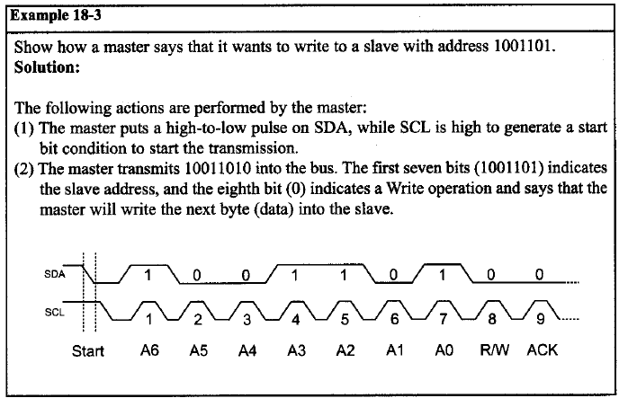
Address Packet Format in I2C

Slide 17
Data Packet Format in I2C
Data packets are 9 bits long. The first 8 bits are a byte of data to be transmitted, and the 9th bit is ACK.
If the receiver has received the last byte of data and there is no more data to be received, or the receiver cannot receive or process more data, it will signal a NACK by leaving the SDA line high.
In data packets, like address packets, MSB is transmitted first.
Combining address and data packets into a transmission
In I2C, normally, a transmission is started by a START condition, followed by an address packet (SLA + R/W), one or more data packets, and finished by a STOP condition.
Figure 18-7 shows a typical data trans-mission.

Slide 18
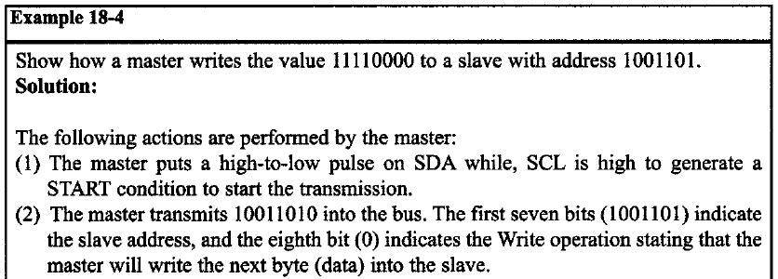
Combining Address and Data Packets

Slide 19
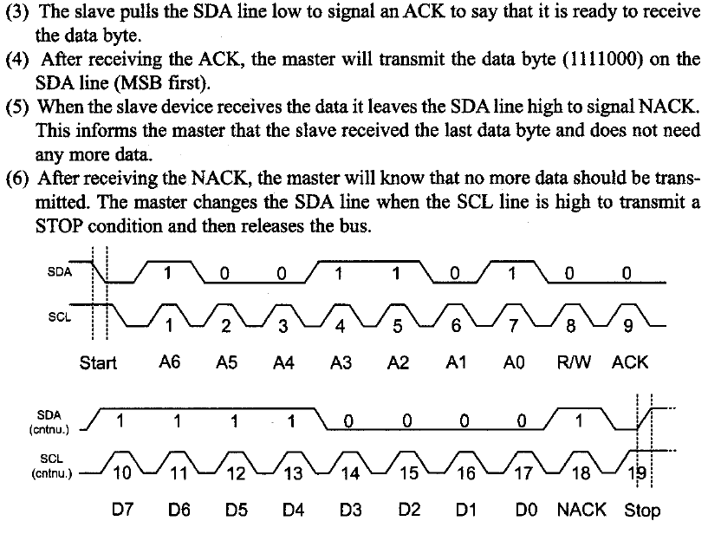

Slide 20
Clock Stretching
One of the features of the PC protocol is clock stretching. It is a kind of flow control.
If an addressed slave device is not ready to process more data it will stretch the clock by holding the clock line (SCL) low after receiving (or sending) a bit of data.
Thus the master will not be able to raise the clock line (because devices are wire-ANDed) and will wait until the slave releases the SCL line to show it is ready to transfer the next bit. See Figure below

Slide 21
Arbitration
I2C protocol supports a multi-master bus system. This doesn't mean that more than one master can use the bus at the same time. Rather, each master waits for the current transmission to finish and then starts to use the bus.
But it is possible that two or more masters initiate a transmission at about the same time. In this case the arbitration happens.
Each transmitter has to check the level of the bus and compare it with the level it expects; if it doesn't match, that transmitter has lost the arbitration, and will switch to slave mode.
In the case of arbitration, the winning master will continue its job. Notice that neither the bus is corrupted nor the data is lost. See Example 18-5.

Slide 22
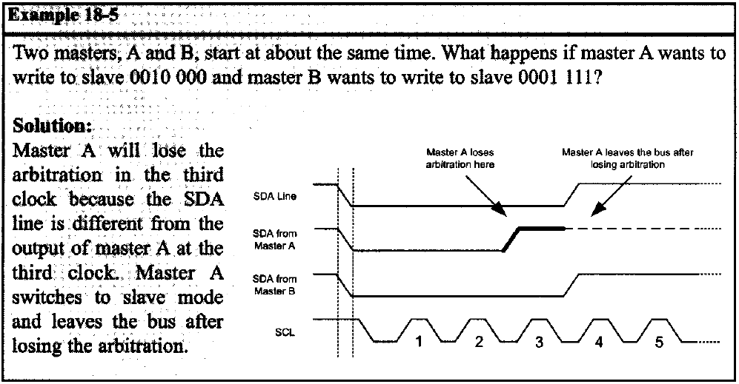
Arbitration

Slide 23
Multibyte burst write
Burst mode writing is an effective means of loading consecutive locations. It is supported in I2C, SPI, and many other serial protocols.
In burst mode, we provide the address of the first location, followed by the data for that location. From then on, consecutive bytes are written to consecutive memory locations.
In this mode, the I2C device internally increments the address location as long as the STOP condition is not detected.
The following steps are used to send (write) multiple bytes of data in burst mode for I2C devices.
Generate a START condition.
Transmit the slave address followed by zero (for write).
Transmit the address of the first location.

Slide 24
Multibyte burst write
Transmit the data for the first location and from then on, simply provide consecutive bytes of data to be placed in consecutive memory locations.
Generate a STOP condition.
Figure 18-9 shows how to write 0x01, 0x02, and 0x03 to three consecutive locations starting from location 00001111 of slave 1111000.

Slide 25
Multibyte burst read
Burst mode reading is an effective way of bringing out the contents of consecutive locations. In burst mode, we provide the address of the first location only.
From then on, contents are brought out from consecutive memory locations. In this mode, the I2C device internally increments the address location as long as the STOP condition is not detected.
The following steps are used to get (read) multiple bytes of data using burst mode for I2C devices.
Generate a START condition
Transmit the slave address followed by zero (for address write).
Transmit the address of the first location.
Generate a START (REPEATED START) condition.
Transmit the slave address followed by one (for read).

Slide 26
Multibyte burst read
Read the data from the first location and from then on, bring contents out from consecutive memory locations.
Generate a STOP condition.
Figure 18-10 shows how to read three consecutive locations starting from location 00001111 of slave number 1111000

Slide 27
TWI (I2C) in AVR
The TWI module in the AVR has four sub-modules:
Bit Rate Generation Unit.
Bus Interface Unit.
Address Match Unit.
Control Unit.

Slide 28
TWI (I2C) in AVR
The bit rate generation unit controls the frequency of the system clock (SCL) when operating in a master mode.
The bus interface unit detects and generates START, REPEATED START and STOP conditions. It also detects arbitration, controls sending or receiving ACK, and also transfers packets of data or address.
The address match unit compares the received address byte with the 7-bit address in TWI address register and informs the control unit upon an address match.
The control unit controls the TWI module and generates responses according to settings in the TWI control register. It also sets the contents of the status register according to current state.

Slide 29
TWI (I2C) in AVR
In the AVR microcontroller, five major registers are associated with the TWI. They are:
TWBR (TWI Bit rate Register)
TWCR (TWI Control Register)
TWSR (TWI Status Register)
TWAR (TWI Address Register)
TWDR (TWI Data Register)
TWI Bit Rate Register (TWBR)
TWBR selects the division factor to control the SCL clock frequency in master mode.
The SCL frequency is controlled by settings in the TWBR and the Prescaler bits in the TWSR (TWI status register).
The following equation demonstrates the relation between SCL frequency, TWBR, and TWPS bits in TWI status register:
TWBR7 | TWBR6 | TWBR5 | TWBR4 | TWBR3 | TWBR2 | TWBR1 | TWBR0

Slide 30

TWI Bit Rate Register (TWBR)
Notice that the value of TWBR should be 10 or higher if the TWI operates in master mode. Example 18-6 shows how the frequency of SCL is calculated.

Slide 31
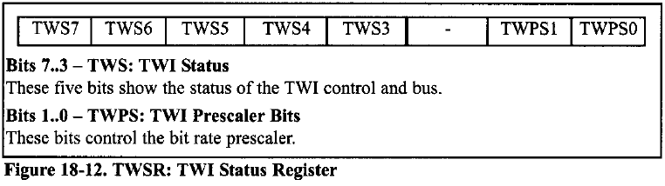
TWI Status Register (TWSR)
Five bits of TWSR are dedicated to show the status of the TWI logic and bus (Fig. 18-12).
To check the status bits, you should mask the two LSB bits (prescaler values) to zero.
Read the data sheet of the chip To see the complete list of status register codes.
Next we will see how to use these bits when we want to program the AVR to use the TWI module.

Slide 32
TWI Control Register (TWCR)
TWCR controls the operation of the TWI.
Bit 7 - TWINT: TWI Interrupt
This bit is set by hardware when the TWI module has finished its current job. If the TWI and general interrupt are enabled, changing TWINT to one will cause the MCU to jump to the TWI interrupt vector. Clearing this flag starts the operation of the TWI. TWINT must be cleared by software.
Bit 6 - TWEA: TWI Enable Acknowledge
Making this bit HIGH will enable the generation of ACK when needed in slave or receiver mode.
Bit 5 - TWSTA: TWI START condition Bit
Making this bit HIGH will generate a START condition if the bus is free; otherwise, the TWI module waits for the bus to become free and then generates a START condition

Slide 33
TWI Control Register (TWCR)
Bit 4 - TWSTO: TWI STOP condition bit
In master mode, making this bit HIGH causes the TWI to generate a STOP condition. This bit is cleared by hardware when the STOP condition is transmitted.
Bit 3 - TWWC: TWI Write Collision Flag
This bit is set HIGH when we attempt to access the TWI Data Register when TWINT is low. This flag is cleared by writing to the TWDR register when TWINT is high.
Bit 2 - TWEN: TWI Enable
Making this bit HIGH enables the TWI module.
Bit 0 - TWIE: TWI Interrupt Enable
Making this bit HIGH enables the TWI interrupt if the general interrupt is enabled.

Slide 34
More Details of Some bits of TWCR
Bit 7 - TWINT: TWI Interrupt
When the TWI hardware finishes its job, it sets the TWINT bit to one.
If the TWI and general interrupts are enabled, changing TWINT to HIGH will cause the MCU to jump to the TWI interrupt vector.
When the TWINT bit is set, the TWI module "stretches" the SCL line to provide enough time for software to do specified jobs.
When the software finishes its job, it must clear the TWINT bit to resume the operation of the TWI module.
Notice that all accesses to the TWI address, status, and data registers must be complete before clearing this flag.
If you try to write to the TWI Data Register when TWINT is low, a collision will happen and the TWI collision flag (TWWC) will be set to HIGH by hardware.
Software can monitor (poll) the TWI bit to know when the TWI module finishes its job and is ready for a new command.

Slide 35
More Details of Some bits of TWCR
Bit 6 - TWEA: TWI Enable Acknowledge
Making this bit HIGH will enable the generation of the ACK bit if any of the following conditions are met:
The TWI Address Match module detects that the TWI module is addressed by receiving its own slave address from the bus.
A general call has been received while the TWGCE bit in the TWAR is set to one (to enable accepting of global calls).
A data byte has been received in each of the receiving modes, master receiver or slave receiver mode.
If you clear the TWEA bit to zero, the device will not generate ACK and will be virtually disconnected from the TWI bus.

Slide 36
More Details of Some bits of TWCR
TWI Start bit and TWI Stop bit (TWSTA and TWSTO)
To generate START or STOP conditions, you have to set the TWSTA or TWSTO bit to one respectively and then clear the TWINT flag to zero by writing a one to it.
TWI Data Register (TWDR)
In Receive mode, the last received byte will be in the TWDR, and in Transmit mode, you should write the next byte into TWDR to be transmitted.
You can access the TWDR only when the TWIE is set to one otherwise collision happens.
This means the Data Register cannot be initialized by the user before the first interrupt occurs.

Slide 37
TWI Address Register (TWAR)
TWAR contains the 7-bit slave address to which the TWI will respond when working as slave.
The eighth bit (LSB) of TWAR is TWGCE (TWI General Call Recognition Enable).
It controls recognition of general call address (000 0000).
If this bit is set to one, receiving of a general call address will cause an interrupt request.

Slide 38
AVR TWI Programming
AVR TWI Programming in master operating mode
To work in master operating mode, we must be able to initialize the TWI, transmit a START condition, send or receive data, and transmit a STOP condition. Next we will discuss each one in more detail.
Initialization
To initialize the TWI module to operate in master operating mode, we should do the following steps:
Set the TWI module clock frequency by setting the values of the TWBR register and the TWPS bits in the TWSR register.
Enable the TWI module by setting the TWEN bit in the TWCR register to one.

Slide 39
AVR TWI Programming
Transmit START condition
To start data transfer in master operating mode, we must transmit a START condition.
This is done by setting the TWEN, TWSTA, and TWINT bits of TWCR to one. Setting the TWEN bit to one enables the TWI module.
Setting the TWSTA bit to one tells the TWI to initiate a START condition when the bus is free, and setting the TWINT bit to one clears the interrupt flag to initiate operation of the TWI module to transmit the START condition.
Then we should poll the TWINT flag in the TWCR register to see whether the START condition transmitted completely.

Slide 40
AVR TWI Programming
Send data
To send a byte of data, after transmitting the START condition, we should do the following steps:
Copy the data byte to the TWDR.
Set the TWEN and TWINT bits of the TWCR register to one to start sending the byte.
Poll the TWINT flag in the TWCR register to see whether the byte transmitted completely.
Notice that right after the START condition, we should transmit SLA + W (Slave Address + Write) or SLA + R (Slave Address + Read).
Right after sending SLA+W we should write to the slave, and right after sending SLA+R we should read from it.

Slide 41
AVR TWI Programming
To transmit SLA + R, SLA + W, and to write a byte of data to a slave we use a function called I2CWIRITE.
Receive data
To receive a byte of data, after transmitting of SLA + R, we should do the following steps:
Set the TWEN and TWINT bits of the TWCR register to one to start receiving a byte. Notice that if you want to return ACK after receiving data you should also set the TWEA bit of the TWCR register to one.
Poll the TWESfT flag in the TWCR register to see whether a byte has been received completely.
Copy the received byte from the TWDR to another register to save it.

Slide 42
AVR TWI Programming
Transmit STOP condition
To stop data transfer, we must transmit a STOP condition. This is done by setting the TWEN, TWSTO, and TWINT bits of the TWCR register to one.
Notice that we cannot poll the TWINT flag after transmitting the STOP condition.
Program 18-1 shows how a master writes 11110000 to a slave with address 1101000.

Slide 43
Master Transmitter (1/2)
#define F_CPU 8000000UL
#include <avr/io.h>
#include <util/delay.h>
void Clock_Set(){
TWSR = 0; // No prescaler
TWBR = 72; // SCL frequency is 50K for XTAL = 8M
}
void Start(void){
TWCR = (1<<TWINT)|(1<<TWEN)|(1<<TWSTA); // Clear TWINT Flag
while ((TWCR & 0x80) == 0); // wait for TWINT Flag to become 1
}
void Write(unsigned char aByte){
TWDR = aByte;
TWCR = (1<<TWINT)|(1<<TWEN);
while ((TWCR & 0x80) == 0);
}

Slide 44
Master Transmitter (2/2)
unsigned char Read(unsigned char ack){
TWCR = (1<<TWINT)|(1<<TWEN)|(1<<TWEA);
while ((TWCR & 0x80) == 0); return TWDR;
}
void Stop(){ TWCR = (1<<TWINT)|(1<<TWEN)|(1<<TWSTO); }
int main (void){
unsigned char ch=0;
Clock_Set();
while(1){
_delay_ms(1000);
Start(); // transmit START condition
Write(0b11010000+0); // transmit SLA + W(0)
Write(ch++); // transmit data
Stop(); // transmit STOP condition
}
return 0 ; }

Slide 45
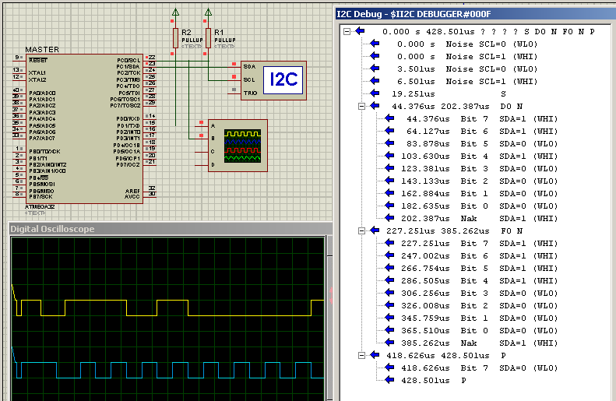
Master Transmitter

Slide 46
Slave Receiver (1/2)
#include <avr/io.h>
void Address_Set(unsigned char address){
TWAR = address;
}
void Listen(unsigned char ack){
TWCR = (1<<TWINT)|(1<<TWEN)|(ack<<TWEA);
while ((TWCR & 0x80) == 0);
}
unsigned char Read(unsigned char ack){
TWCR = (1<<TWINT)|(1<<TWEN)|(ack<<TWEA);
while ((TWCR & 0x80) == 0);
return TWDR;
}

Slide 47
Slave Receiver (2/2)
void Write(unsigned char aByte){
TWDR = aByte;
TWCR = (1<<TWINT)|(1<<TWEN);
while ((TWCR & 0x80) == 0);
}
int main (){
DDRA = 0xFF; // PORTA is output
Address_Set(0b11010000); // enable slave at address
// 01101000 and do not accept general call
while(1){
Listen(1); // send ACK when master connects
PORTA = Read(1); // receive byte and send ACK
}
return 0 ;
}

Slide 48
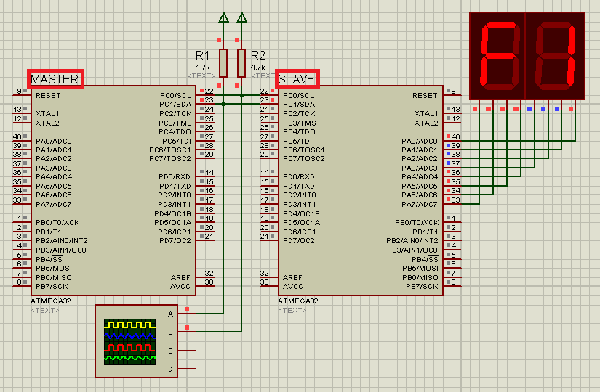
Master Transmitter Slave Receiver

Slide 49
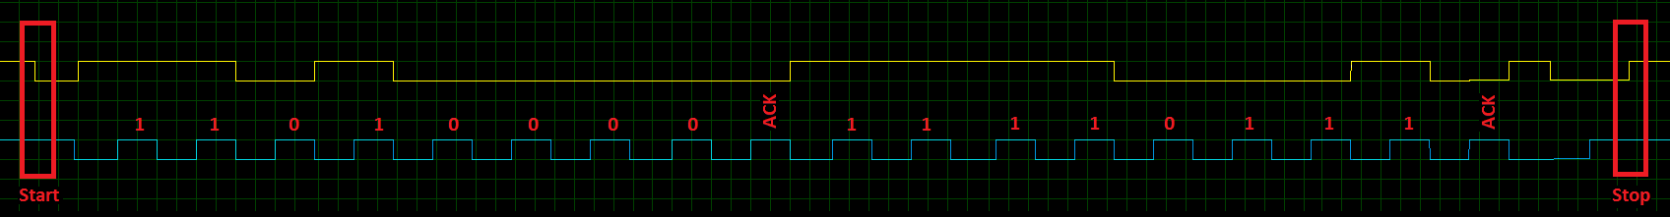
Master Transmitter Slave Receiver
Write

Slide 50
Master Receiver (1/2)
#define F_CPU 8000000UL
#include <avr/io.h>
#include <util/delay.h>
void Clock_Set(){
TWSR = 0; // No prescaler
TWBR = 72; // SCL frequency is 50K for XTAL = 8M
}
void Start(void){
TWCR = (1<<TWINT)|(1<<TWEN)|(1<<TWSTA); // Clear TWINT Flag
while ((TWCR & 0x80) == 0); // wait for TWINT Flag to become 1
}
void Write(unsigned char aByte){
TWDR = aByte;
TWCR = (1<<TWINT)|(1<<TWEN);
while ((TWCR & 0x80) == 0);
}

Slide 51
Master Receiver (2/2)
unsigned char Read(unsigned char ack){
TWCR = (1<<TWINT)|(1<<TWEN)|(1<<TWEA);
while ((TWCR & 0x80) == 0);
return TWDR; }
void Stop(){ TWCR = (1<<TWINT)|(1<<TWEN)|(1<<TWSTO); }
int main (void){
DDRA = 0xFF; Clock_Set();
while(1){
_delay_ms(1000);
Start(); // transmit START condition
Write(0b11010000+1); // transmit SLA + R(1)
PORTA = Read(1); // Read data and send ACK
Stop(); // transmit STOP condition
}
return 0 ; }

Slide 52
Slave Transmitter (1/2)
#include <avr/io.h>
void Address_Set(unsigned char address){
TWAR = address;
}
void Listen(unsigned char ack){
TWCR = (1<<TWINT)|(1<<TWEN)|(ack<<TWEA);
while ((TWCR & 0x80) == 0);
}
unsigned char Read(unsigned char ack){
TWCR = (1<<TWINT)|(1<<TWEN)|(ack<<TWEA);
while ((TWCR & 0x80) == 0);
return TWDR;
}

Slide 53
Slave Transmitter (2/2)
void Write(unsigned char aByte){
TWDR = aByte;
TWCR = (1<<TWINT)|(1<<TWEN);
while ((TWCR & 0x80) == 0);
}
int main (){
unsigned char ch=0;
DDRA = 0xFF; // PORTA is output
Address_Set(0b11010000); // enable slave at address
// 01101000 and do not accept general call
while(1){
Listen(1); // send ACK when master connects
Write(ch++); // receive byte and send ACK
}
return 0 ;
}

Slide 54
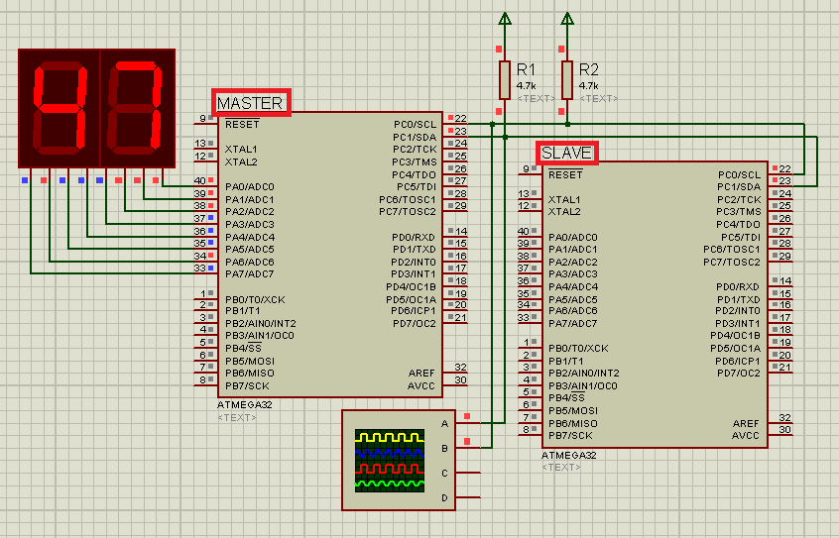
Master Receiver and Slave Transmitter

Slide 55
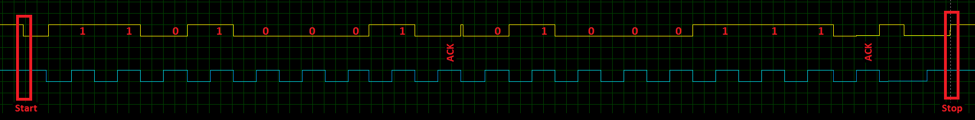
Master Receiver and Slave Transmitter
Read

Slide 56
Using Real Time Clock (RTC) DS1307
The RTC is widely used device that provides accurate time and date information.
The DS1307 IC provides seconds, minutes, hours, day, date, month and year information.
The end of the month date is automatically adjusted for months with fewer than 31 days, including corrections for leap year.
The clock operates in either the 24-hour or 12-hour format with AM/PM indicator.
The DS1307 has a built-in power-sense circuit that detects power failures and automatically switches to the battery supply.
The DS1307 does not support the Daylight Savings Time option. Next, we describe the pins of the DS1307. See Figure 18-14.

Slide 57
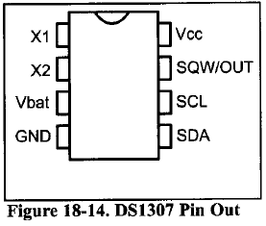
Using Real Time Clock (RTC) DS1307
X1-X2: These are input pins that allow the
DS1307 connection to an external crystal
oscillator to provide the clock source to the
chip. We must use the standard 32.768 kHz
quartz crystal.
Vbat: Pin 3 can be connected to an external +3 V lithium battery, thereby providing the power source to the chip when the external supply voltage is not available. We must connect this pin to ground if it is not used. A 48mAhr lithium battery can provide the power needed for more than 10 years to back up the chip.
GND: Pin 4 is the ground.
SDA (Serial Data): Pin 5 is the SDA pin and must be connected to the SDA line of the I2Cbus.

Slide 58
Using Real Time Clock (RTC) DS1307
SCL (Serial Clock): Pin 6 is the SCL pin and
must be connected to the SCL line of the I2C
bus.
SWQ/OUT: Pin 7 is an output pin providing
1 kHz, 4 kHz, 8 kHz, or 32 kHz frequency if
enabled. This pin needs an external pull-up resistor to generate the frequency because it is open drain. If you do not want to use this pin you can omit the external pull-up resistor.
Vcc: Pin 8 is used as the primary voltage supply to the chip. This primary voltage source is generally set to +5 V. When Vcc falls below the Vbat level, the DS1307 switches to Vbat and the external lithium battery provides power to the RTC.

Slide 59
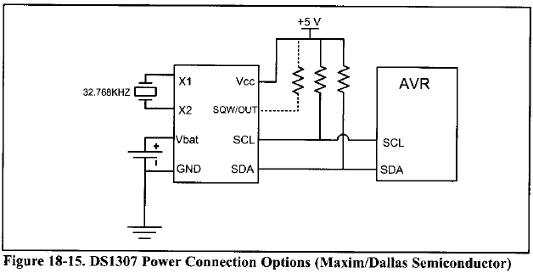
Power Connections for DS1307

Slide 60
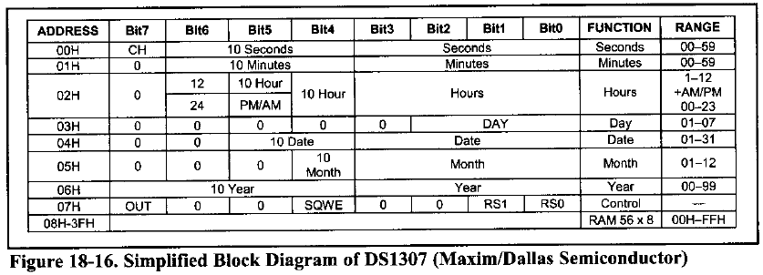
Address map of the DS1307
The DS1307 has a 64 bytes of RAM with addresses 00-3FH.
The first seven locations, 00-06, are set aside for RTC values of time and date. The next byte is used for the control register.
That leaves 56 bytes, from addresses 07H to 3FH, available for general-purpose data storage.

Slide 61
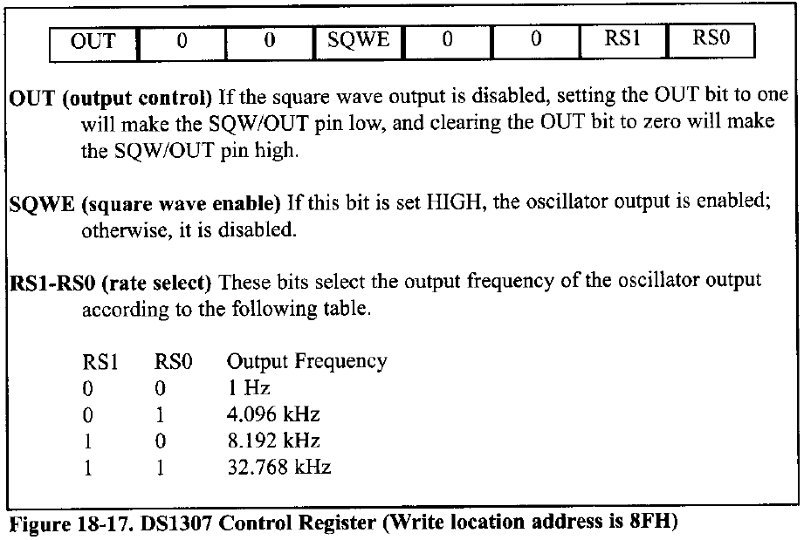
The DS1307 Control Register

Slide 62
CH bit in address 00
One of the most important bits in the Seconds address location in the DS1307 is the CH (Clock Halt) bit. It is the seventh bit of address location 00. Setting the CH bit to one disables the oscillator, while setting CH to zero enables the oscillator.
The CH bit is undefined upon reset. In order to enable the oscillator, we must clear the CH during initial configuration.
Register Pointer
In DS1307 there is a register pointer that specifies the byte that will be accessed in the next read or write command.
After each read or write operation, the content of the register pointer is automatically incremented.
It is useful in multi-byte read or write.

Slide 63
Time and date address locations and modes
The byte addresses 0 to 6 are set aside for the time and date.
The DS1307 provides data in BCD format only.
Notice the data range for the hour mode. We can select 12-hour or 24-hour mode with bit 6 of hour location 02.
When D6 = 1, the 12-hour mode is selected, and D6 = 0 provides us the 24-hour mode.
In the 12-hour mode, we decide the AM and PM with the bit 5. If D5 = 0, the AM is selected and D5 = 1 is for the PM. See Example 18-7.

Slide 64
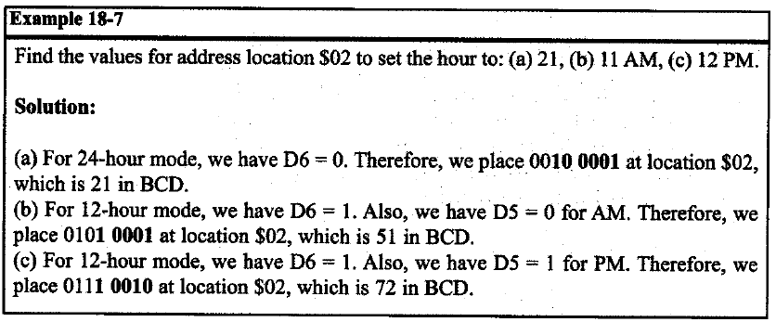
Time and date address locations and modes

Slide 65
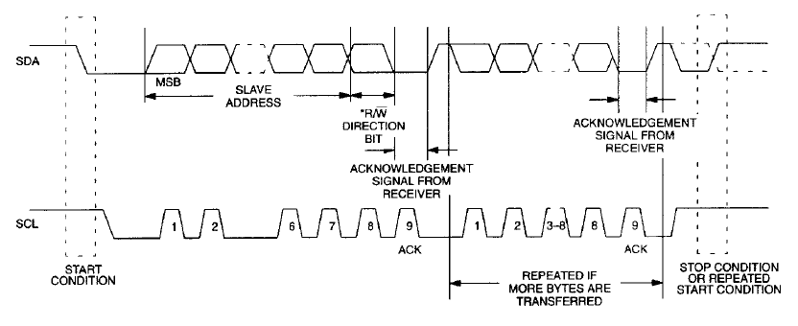
Data Transfer on a 2-Wire Serial Bus
Notes:
Depending upon the state of the R/W bit, two types of data transfer are possible:
1. Data transfer from a master transmitter to a slave receiver. The first byte transmitted by the
master is the slave address. Next follows a number of data bytes. The slave returns an acknowledge
bit after each received byte. Data is transferred with the most significant bit (MSB) first.
2. Data transfer from a slave transmitter to a master receiver. The first byte (the slave address) is
transmitted by the master. The slave then returns an acknowledge bit. This is followed by the slave
transmitting a number of data bytes. The master returns an acknowledge bit after all received bytes
other than the last byte. At the end of the last received byte, a “not acknowledge” is returned.

Slide 66
Writing to DS1307
In DS1307 there is a register pointer that specifies the byte that will be accessed in the next read or write command.
After each read or write operation, the content of the register pointer is automatically incremented.
It is useful in multi-byte read or write.
To access the DS1307 for a write operation, after sending a START condition, you should transmit the address of DS1307 (1001101) followed by 0 to indicate a write operation.
The first byte of data in the write operation will set the register pointer. For example, if you want to access the control register you should send 0x07.
If you want only to set the register pointer you should skip this step. If you want to write one or more bytes of data, you should

Slide 67
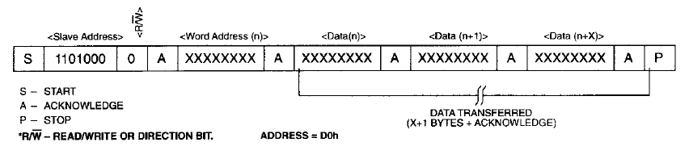
Writing to DS1307
transmit them one byte at a time. Remember that the register pointer is automatically incremented and you can simply transmit bytes of data to consecutive locations in a multi-byte burst write.
Transmit a STOP bit condition.

Slide 68
Reading from DS1307
Notice that before reading a byte you should load the address of the byte to the register pointer by doing a write operation.
To read one or more bytes of data from the DS1307 you should do the following steps:
To access the DS1307 for a read operation, after sending a START condition, you should transmit the address of DS1307 (1001101) followed by 1 to indicate a read operation.
Now you can read one or more bytes of data. Remember that the register pointer indicates which address will be read. Also notice that the register pointer is automatically incremented and you can simply receive consecutive bytes of data in a multi-byte burst read.
Transmit a STOP bit condition.

Slide 69
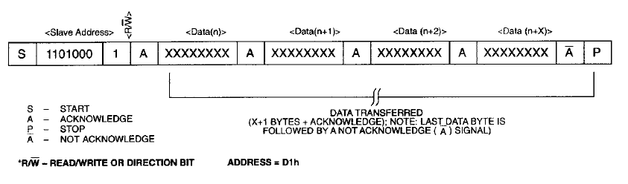
Reading from DS1307
Transmit a STOP bit condition.

Slide 70
Comm. with DS1307, Setting time (1/2)
#include <avr/io.h>
void I2C_Stop(void){
TWCR = (1<<TWINT) | (1<<TWEN) | (1<<TWSTO);
}
void I2C_Write(unsigned char data){
TWDR = data;
TWCR = (1<<TWINT) | (1<<TWEN) ;
while (!(TWCR & (1<<TWINT) ) ) ;
}
void I2C_Start(void){
TWCR = (1<<TWINT) | (1<<TWEN) | (1<<TWSTA);
while (!(TWCR & (1<<TWINT)));
}
void I2C_Init(void){
TWSR = 0x00; // set prescaler bits to zero
TWBR = 32; // SCL freq. is 100k for XTAL=8M
}

Slide 71
Comm. with DS1307, Setting time (2/2)
void RTC_Set_Time(unsigned char hour, unsigned char min,
unsigned char sec)
{
I2C_Start(); // transmit START condition
I2C_Write(0b11010000); // address DS1307 for write
I2C_Write(0); // set register pointer to 0
I2C_Write(sec); // set seconds
I2C_Write(min); // set minuts
I2C_Write(hour); // set Hours
I2C_Stop(); } // transmit STOP condition
int main ()
{
I2C_Init();
RTC_Set_Time(0x12,0x50,0x30); // sec, min, hours
while(1);
return 0;
}

Slide 72
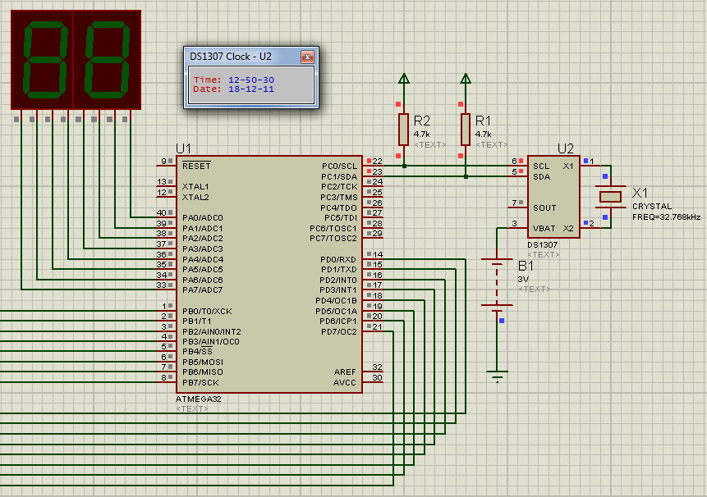
Comm. with DS1307, Setting time

Slide 73
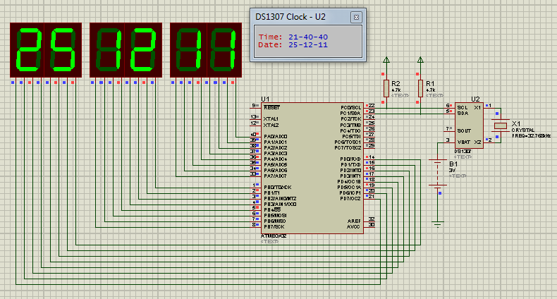
DS1307, Setting/Reading Date & Time

Slide 74
DS1307, Setting/Reading Date & Time (1/4)
#include <avr/io.h>
#include <util/delay.h>
unsigned char hour, mint, second, day, month, year;
void I2C_Init(){
TWSR=0x00; // set prescaler bits to zero
TWBR=32; // SCL freq. is 100k for XTAL=8M
}
void I2C_Start(){
TWCR = (1<<TWINT) | (1<<TWEN) | (1<<TWSTA);
while (!(TWCR & (1<<TWINT))); }
void I2C_Stop(){
TWCR = (1<<TWINT) | (1<<TWEN) | (1<<TWSTO);}
void I2C_Write(unsigned char data){
TWDR = data;
TWCR = (1<<TWINT) | (1<<TWEN) ;
while (!(TWCR & (1<<TWINT) ) ) ;}

Slide 75
DS1307, Setting/Reading Date & Time (2/4)
unsigned char I2C_Read(unsigned char ack){
TWCR = (1<<TWINT) | (1<<TWEN)|(ack<<TWEA) ;
while (!(TWCR & (1<<TWINT) ) ) ; return TWDR; }
void RTC_Set_Time() {
I2C_Start(); // transmit START condition
I2C_Write(0xD0); // address DS1307 for write
I2C_Write(0); // set register pointer to 0
I2C_Write(second); // set seconds
I2C_Write(mint); // set minuts
I2C_Write(hour); // set Hours
I2C_Stop(); }
void RTC_Set_Date() {
I2C_Start(); // transmit START condition
I2C_Write(0xD0); // address DS1307 for write
I2C_Write(0x04); // set register pointer to 4
I2C_Write(day); // set day
I2C_Write(month); // set month
I2C_Write(year); // set year
I2C_Stop(); }

Slide 76
DS1307, Setting/Reading Date & Time (3/4)
void RTC_Get_Time(){
I2C_Start () ; //transmit START condition
I2C_Write(0xD0); //address DS1307 for write
I2C_Write(0); //set register pointer to 0
I2C_Start () ; //transmit START condition
I2C_Write(0xD1); //SLA+R(1) address DS1307 for read
second = I2C_Read(1); //read second, return ACK
mint = I2C_Read(1); //read minute, return ACK
hour = I2C_Read(0); //read hour, return NACK
I2C_Stop(); } //transmit STOP condition
void RTC_Get_Date() {
I2C_Start () ; //transmit START condition
I2C_Write(0xD0); //address DS1307 for write
I2C_Write(4); //set register pointer to 4
I2C_Start () ; //transmit START condition
I2C_Write(0xD1); //address DS1307 for read
day = I2C_Read(1); //read second, return ACK
month = I2C_Read(1); //read minute, return ACK
year = I2C_Read(0); //read hour, return NACK
I2C_Stop(); } //transmit STOP condition

Slide 77
DS1307, Setting/Reading Date & Time (4/4)
int main (void){
DDRA = DDRB = DDRD = 0xFF;
I2C_Init (); // initialize I2C module
hour = 0x21; mint = 0x40 ; second = 0x30;
RTC_Set_Time(); // Set time 21:40:30
day = 0x25; month = 0x12 ; year = 0x11;
RTC_Set_Date(); // Set date 25-12-2010
while(1){
RTC_Get_Time();
PORTD = hour; PORTB = mint; PORTA = second;
_delay_ms(2000);
RTC_Get_Date();
PORTD = day; PORTB = month; PORTA = year;
_delay_ms(2000);
}
return 0;
}

